Slide 1
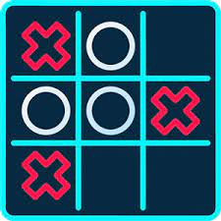
Tic Tac Toe
Presented By :
Sakshi Kumari Sinha (22CSE009)
Ekata kumari (22CSE048)
Sarmistha parija (22CSE1057)

Slide 2
Introduction
Our website is designed for casual users who wants to develop their critical thinking and logical reasoning.
The aim of this website is to entertain the players along with strategic thinking.
This website can be used as mean time refreshment for the users.
As our project is based on web application it can be enabled and access by the users anywhere anytime.

Slide 3
Names :
In American English , the game is known as "tic-tac-toe".
In Commonwealth English (particularly British, South African, Australian and New Zealand English), the game is known as "noughts and crosses".
This name derives from the shape of the marks in the game (i.e the X and O); "nought" is an older name for the number zero, while "cross" refers to the X shape. While the term nought is now less commonly used, the name "noughts and crosses" is still preferred over the American name "tic-tac-toe" in these countries.

Slide 4
Description :
Tic-tac-toe , noughts and crosses , or Xs and Os is a paper-and-pencil game for two players who take turns marking the spaces in a three-by-three grid with X or O. The player who succeeds in placing three of their marks in a horizontal, vertical, or diagonal row is the winner.

Slide 5
Abstract
The Tic Tac Toe game, also known as "Noughts and Crosses," is a classic two-player board game that has been enjoyed by people of all ages for generations.
Tic Tac Toe is typically played on a 3x3 grid, though larger grids are possible for more advanced versions. The game's objective is simple: two players take turns marking empty cells with their respective symbols, usually 'X' and 'O,' with the goal of forming a continuous line of their symbols either horizontally, vertically, or diagonally. The player who succeeds in creating such a line first wins the game, and if the entire grid is filled without a winner, the game ends in a draw.
It is often used as a simple icebreaker or a quick mental exercise, making it a versatile and timeless game for casual play.
the digital age has seen the emergence of mobile and online versions of Tic Tac Toe, allowing players to enjoy the game anytime, anywhere.

Slide 6

Gameplay
Tic-tac-toe is played on a three-by-three grid by two players, who alternately place the marks X and O in one of the nine spaces in the grid.
In the following example, the first player (X) wins the game in seven steps:
g

Slide 7
Continue :
There is no universally agreed rule as to who plays first, but in this article the convention that X plays first is used .
Players soon discover that the best play from both parties leads to a draw. Hence, tic-tac-toe is often played by young children who may not have discovered the optimal strategy .

Slide 8
Objective
Our primary goal is to provide a digital platform where people of all ages can play, enjoy, and learn from the timeless game of Tic Tac Toe. We aim to create an engaging, educational, and entertaining experience for users.
Online Tic Tac Toe Game
User-Friendly Interface
Accessibility
Educational Resources
Duo player Mode
Global Reach

Slide 9
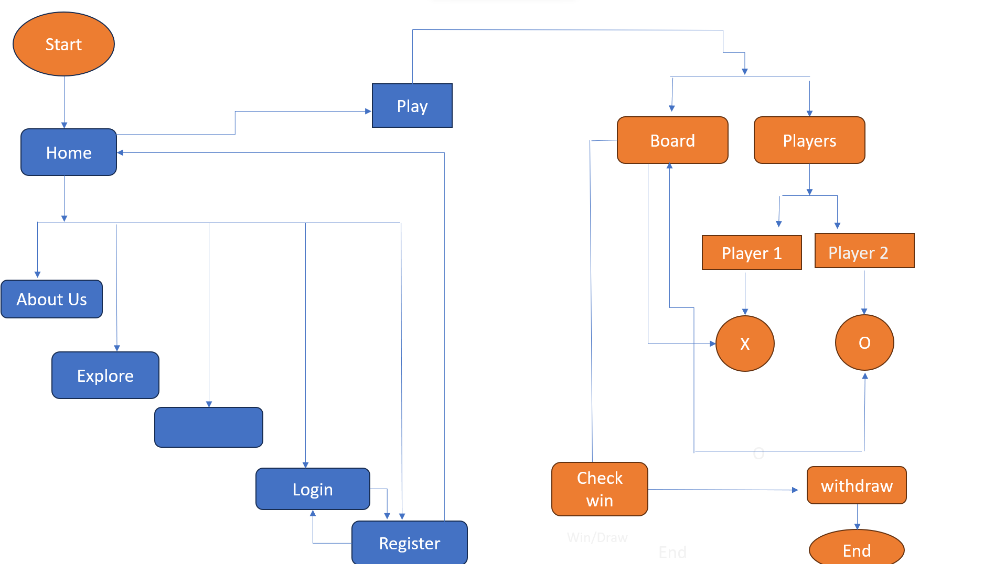
Flow Chart
Win/Draw

Slide 10
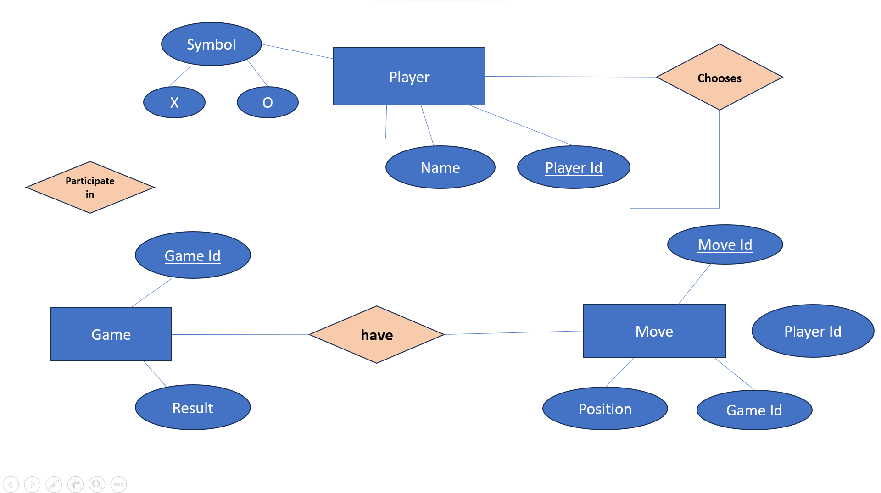
ER Diagram

Slide 11
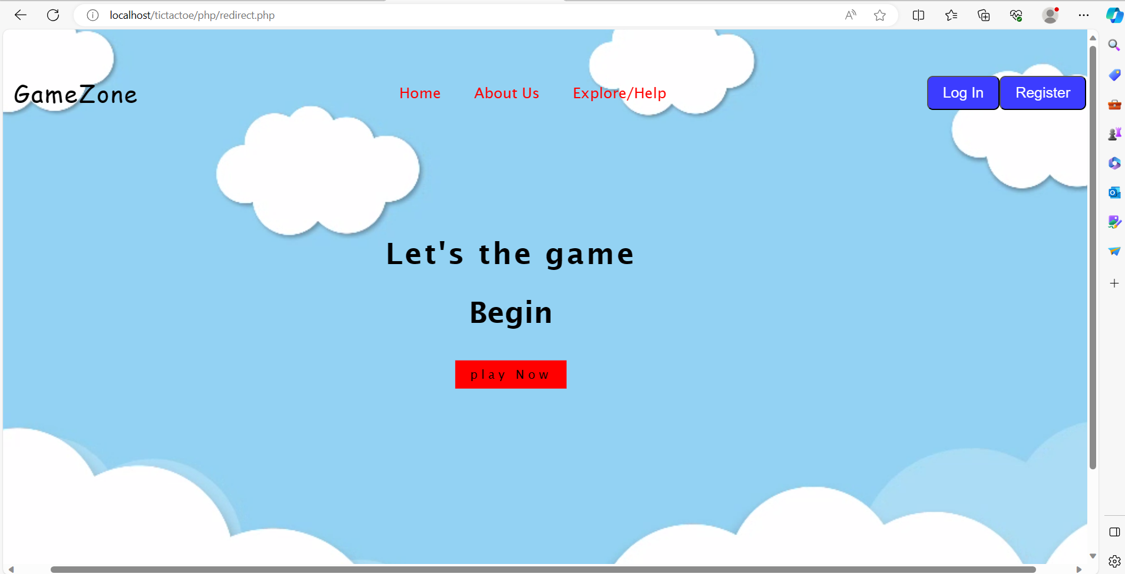
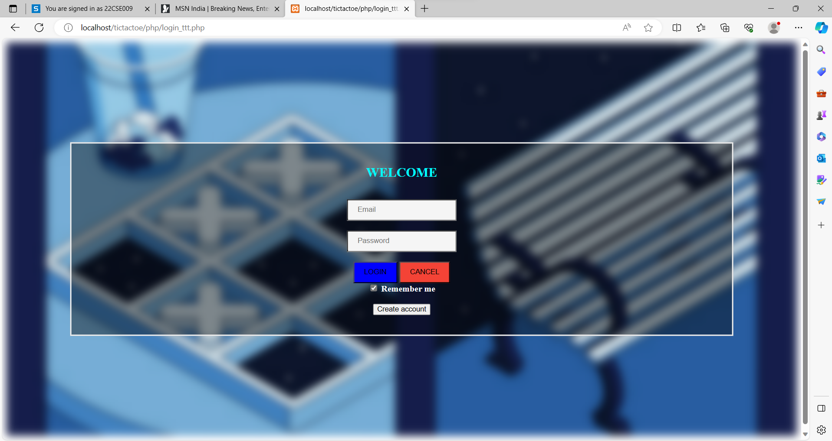
Pictures

Slide 12
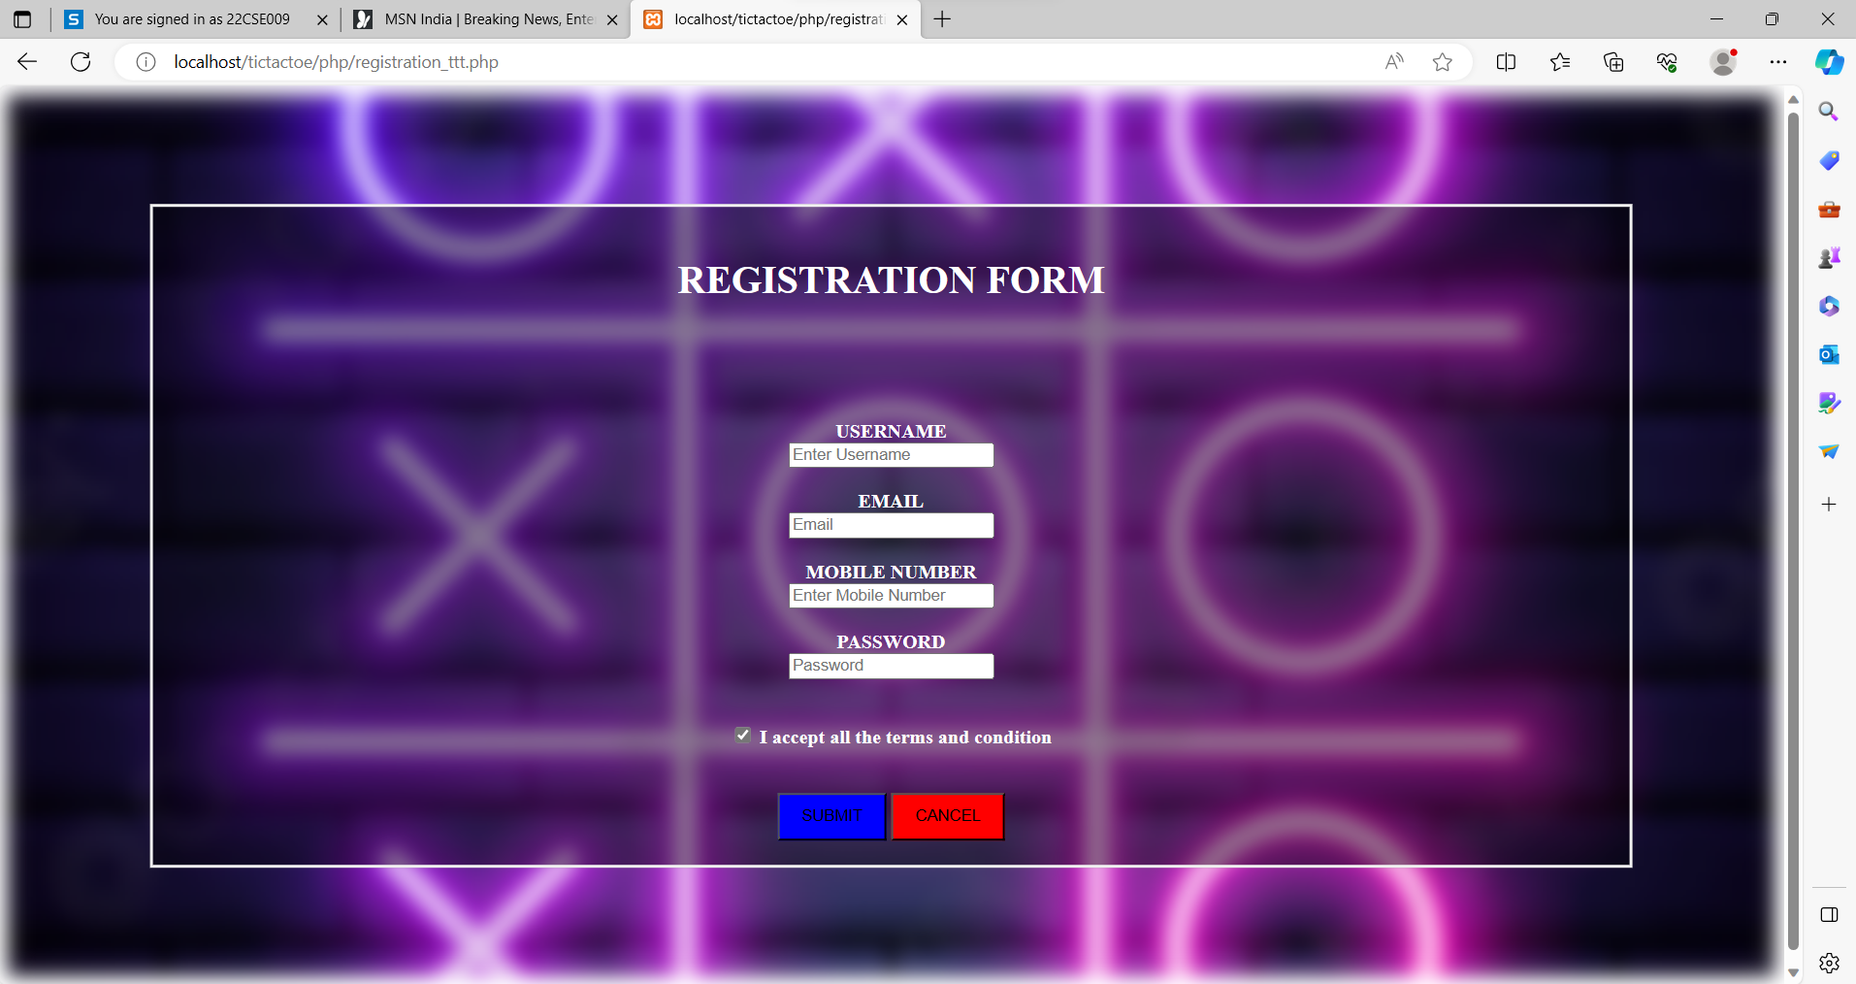

Slide 13
Conclusion
Tic Tac Toe website is a educational gaming platform where player can develop their stratergic thinking by playing .
Tic Tac Toe game is a cherished pastime for every age group player.
Its simplicity holds its place in the world of recreational gaming. Whether played on a piece of paper, a wooden board, or a digital screen , Tic Tac Toe captures the attention and engage players from all around the world.
Our project is all about creating a user-friendly and accessible Tic Tac Toe website that caters to a diverse audience.

Slide 14
Thank You

Slide 15
Code Description :
We have created three functions .
void printBoard(); - this function is to display the board where we play.
int checkWin(); - this function checks the winning condition i.e who won the game,or the game draw .
void system(); - this is used to clear the board.
And the main function.

Slide 16
Continue :
Then we have declared an array named board[] which consist of 9 elements 1 to 9 which helps the player to input mark on the specified box.
Then comes our main function ,
At first we have initialized player with 1 , input ( it is the value that player enters ) and status with -1 ( it continues the loop until player won or match draws ) .
Then we are calling the function printboard() .

Slide 17
Continue :
In while loop ,
At first we are changing the player ( as the game requires two players) because we have initialized the player=1.
Then we have taken a char type variable named as mark which places the X and O mark on board with respect to player.
Then taking input of the players.

Slide 18
Continue :
Then we are inputing the mark on the respective board location .
Then again printing board.
Then checking the result.
At last we are incrementing player.
This completes the while loop.

Slide 19
Void printBoard()
Firstly it clears the board.
Secondly we have created the board.

Slide 20
Int checkWin()
In this we are checking the possible win cases.
There are three cases to win .
Horizontal , vertical , and diagonal , and returns 1 that means win case.
Then we have initialized I (it’s a counter variable for For loop ) and count=0.
For loop goes from i=1 t0 9 incremented by 1
Inside for , If is there which counts the boxes filled.
If count==9 , then the function returns 0 that means draw;
Else returns -1 which continues the loop.
This completes the code.

Slide 21
Start
Flow Chart
Board
Players
Player 1
Player 2
Check win
X
O
Win/Draw
End

